Slide 1

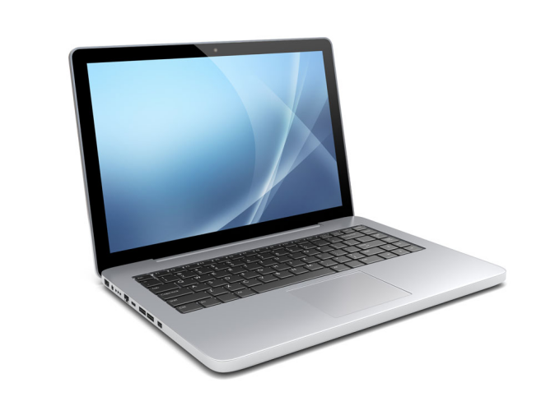
Door (to enter exam hall)
Exit Camera (1)
Enter Camera (2)
Enter Video Input
Exit Video Input

Slide 2
Door (to enter exam hall) – Side View
Exit Camera (1)
Enter Camera (2)
Detected Face(s) compared against collection of students’ faces

Slide 3
Door (to enter exam hall) – Side View
Exit Camera (1)
Enter Camera (2)
Student Recognized:
Name: Steve Chan
SID: 532..234
Timestamp: 19:00
…

Slide 4
Door (to enter exam hall) – Side View
Exit Camera (1)
Enter Camera (2)
Student Recognized:
Name: Steve Chan
SID: 532..234
Timestamp: 21:05
…

Slide 5
Steve Chan:
Enter Time: 19:05
Exit Time: 21:05
CASE: If student takes break,
Mike Wong:
Enter Time: 19:05
Exit Time: 19: 30
Enter Time: 19:37
Exit Time: 21:05
Time taken for break

Slide 6


